Slide 1
Lesson 7:
Programming in Python

Slide 2
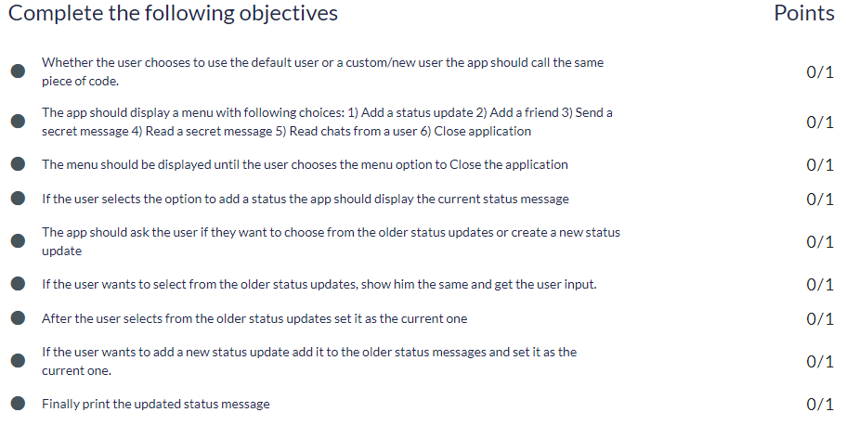
Objective from ACADVIEW website

Slide 3
Well, what modules have we built in our spychat project
Profile of a spy
A menu of choices
Status message for a spy
Add a spy friend(today)
Send and read a secret message
Save chats

Slide 4
Schematic diagram of the code
Start
Ask user if he wants to continue with the default settings or not?
import default
Initialize spy details with default
Take Input from the user and initialize the spy details.
Validate name and age of the spy
Print spy details

Slide 5
start_chat()
add_status()
1. Add a Status
Display current message
2. Add Friend
3. Send a secret message
If current_status_messgae == None
NO
YES
4. Read a secret message
5. Read chat of the user
6. Close Application
Print current_status_message
Print “You do not have current_status_message”
Give option to update from older status message
NO
YES
input new_status_message
Print STATUS_MESSAGE
Check if new_status_message is not empty
Input the choice from the user
Set updated_message = new_status_message
Set updated_message = new_status_message

Slide 6
Let’s start working on our next module:
Add New Friends

Slide 7
Add new friends
We will start by creating different lists to hold friend names, friend ages and friend ratings.
friends_name = []
friends_age = []
friends_rating = []
friends_is_online = []
After the declaration of these lists, let's proceed to create a function add_friend(). The function add_friend will ask the user for the name, age and rating of their spy friend.
def add_friend():
new_name = input("Please add your friend's name:")
new_salutation = input("Are they Mr. or Ms.?: ")
new_name = new_name + " " + new_salutation
new_age = input("Age?")
new_rating = input("Spy rating?")

Slide 8
Add new friends
The function checks that name is not empty, age is greater than 12 and rating of the friend spy is greater than or equal to the user spy rating.
def add_friend():
new_name = input("Please add your friend's name:")
new_salutation = input("Are they Mr. or Ms.?: ")
new_name = new_name + " " + new_salutation
new_age = input("Age?")
new_rating = input("Spy rating?")
#Validate Name and Age
if new_name.isalpha() == True and new_age > 12 and new_rating >= spy_rating:
friends_name.append(new_name)
friends_age.append(new_age)
friends_rating.append(new_rating)
friends_is_online.append(True)
else:
print("Sorry! Invalid entry.")

Slide 9
Code Refactoring

Slide 10
Code Refactoring
Code refactoring is the process of restructuring existing computer code—changing the factoring—without changing its external behavior.
Refactoring improves nonfunctional attributes of the software.
Advantages include improved code readability and reduced complexity.
These can improve source-code maintainability and create a more expressive internal architecture or object model to improve extensibility.

Slide 11
Code Refactoring
Right now, we are storing a spy's details in four distinct variables spy_name, spy_age, spy_rating and spy_is_online.
spy_name = 'bond'
spy_age = 24
spy_rating = 4.7
spy_is_online = True
This also makes it necessary for us to create four distinct lists friends_name, friends_age, friends_rating and friends_is_online for each of these variables to keep track of the spy's friends.
friends_name = []
friends_age = []
friends_rating = []
friends_is_online = []

Slide 12
In this approach
we need to keep track of many variables and lists which makes even the simplest of operations unnecessarily complicated.

Slide 13
Code Refactoring(Contd.)
To demonstrate this, let us try to run through the steps for seeing all the details of a friend named 'Jamie'.
Go through each element in the friends_name list to find an element with the value 'Jamie'.
Find out the index of this element.
Print the value in the same index in friends_age list.
Print the value in the same index in friends_rating list.
Print the value in the same index in friends_is_online list.

Slide 14
As the example suggests,
using a single variable for each spy would mean that
we can print all the details of a spy as soon as
we find a spy with that name in the list
making the previous operation much simpler.
This can be implemented using a data type called Dictionary.

Slide 15
Code Refactoring(Contd.)
Let us modify the spy_details file to have a single variable of dictionary data type for storing all the details of the spy.
spy = {
'name': 'bond',
'salutation': 'Mr.',
'age': 24,
'rating': 4.7,
'is_online': True
}
The variables storing a spy's details are now stored in key (variable name) value pairs inside a single dictionary element assigned to each spy.

Slide 16
Code Refactoring(Contd.)
Since we modified the spy_details file, we'll have to modify the import statement in the main file.
from spy_details import spy
Notice how we're only importing one variable for the spy details.
We'll also need to change every line of code which is making use of the four variables.
#For Example
question ="Do you want to continue as " + spy_salutation + " " + spy_name + "(Y/N)?"
#Is Changed To
question = "Do you want to continue as " + spy['salutation'] + " " + spy['name'] + "(Y/N)?"
#Syntax for reading an element of a dictionary is the same as for accessing #elements of lists

Slide 17
Code Refactoring(Contd.)
What should happen when we want to read the value of a key that doesn't exist in a dictionary?
dict = {
'Python':'A',
'Java':'B'
}
print dict['JavaScript']
Python gives an error called KeyError.
KeyError: 'JavaScript'
KeyError is raised whenever we ask for information about some key the dictionary knows nothing about.
Whenever you see this you should immediately check the line of code it occurred on and what key and dictionary it contains.

Slide 18
Code Refactoring(Contd.)
What if we want to check if a key exists in the dictionary.
if 'key_name' in dictionary_name:
print "Key present."
else:
print "Key does not exist."
Using the If Statement, we can tell Python to read the value of a key only if it exists in the dictionary, hence avoiding the KeyError.
Similarly, we'll have to change the use of any of the four variables to a corresponding key in the dictionary element spy everywhere else in the main program and start_chat function.
That is, spy['name'] is used instead of spy_name.

Slide 19
Code Refactoring(Contd.)
Since we are not using four independent variables for spy details, we don't need to use four separate lists for keeping the details of the spy's friends anymore.
We can just maintain a single list for all the friends of the spy where each element of the list represents a friend.
friends = []
Hence, each element of the list will be of dictionary data type. We'll need to change the add_friend function to append dictionary elements to the newly created list.

Slide 20
Code Refactoring(Contd.)
Let’s create a function to take input
def add_friend():
new_friend = {
'name': '',
'salutation': '',
'age': 0,
'rating': 0.0
}
new_friend['name'] = input("Please add your friend's name: ")
new_friend['salutation'] = input("Are they Mr. or Ms.?: ")
new_friend['name'] = new_friend['salutation'] + " " + new_friend['name']
new_friend['age'] = input("Age?")
new_friend['rating'] = input("Spy rating?")

Slide 21
Code Refactoring(Contd.)
Adding validation to name and age
def add_friend():
…
…
if new_friend['name'].isalpha() == True and new_friend['age'] > 12 and new_friend['rating'] >= spy['rating']:
friends.append(new_friend)
else:
print('Sorry! Invalid entry.')
return len(friends)
We end the function by returning the number of friends the user has

Slide 22
Schematic Diagram of our Code
#Dictionary
spy = {
'name': 'bond',
'salutation': 'Mr.',
'age': 24,
'rating': 4.7,
'is_online': True
}
def start_chat()
spy
friends = [ ]
def add_status()
def add_friend()
STATUS_MESSAGES = []

Slide 23
Adding a feature
to send a message to a friend.

Slide 24
To send someone a message on Whatsapp, we need to make a selection in Contacts first.
Let us create a function select_a_friend to choose from the list of spy friends added by the user.
This function will:
Print out all the friends of the user.
Ask the user to select from one of the friends.
Return the index of the selected friend in the friends list.

Slide 25
Sending message to a friend
def select_friend:
item_number = 0
#Printing all the friends of a User
for friend in friends:
print('%d. %s' % (item_number + 1), friend['name'])
item_number = item_number + 1
#Asking the user to select a friend
friend_choice = input("Choose from your friends")
friend_choice_position = friend_choice - 1
#Returning the index
return friend_choice_position

Slide 26
We’ll continue in next class..
Any questions?

